Slide 1
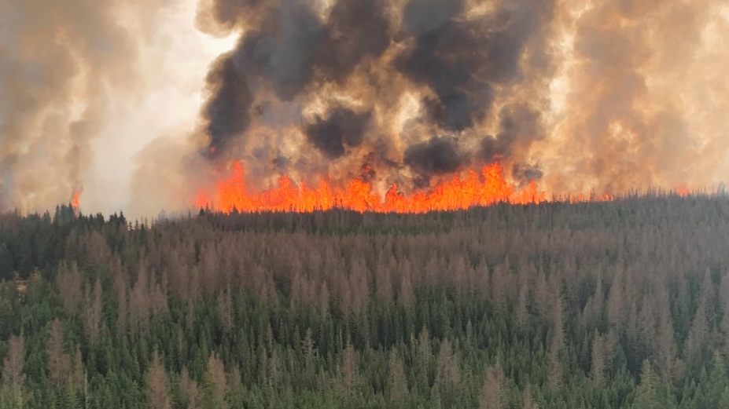


Forecasting Natural Gas Production in Alberta Through Wildfire Analysis
Yong Lee, Jacob Winch For Energy Hackathon 2024

Slide 2
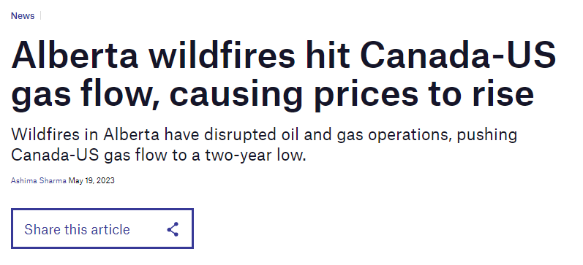
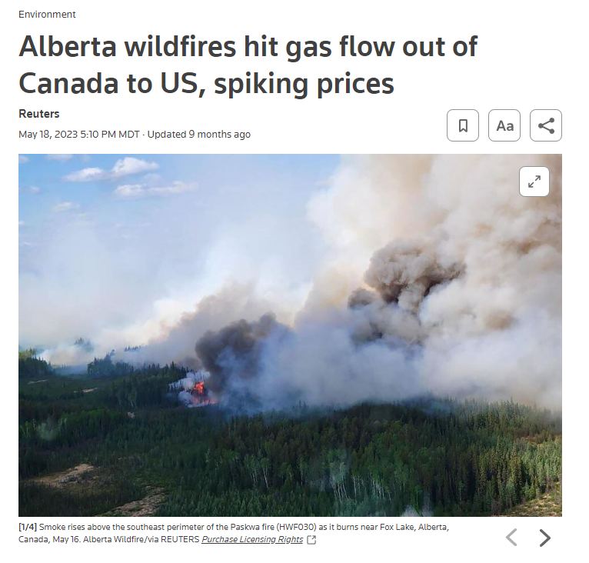
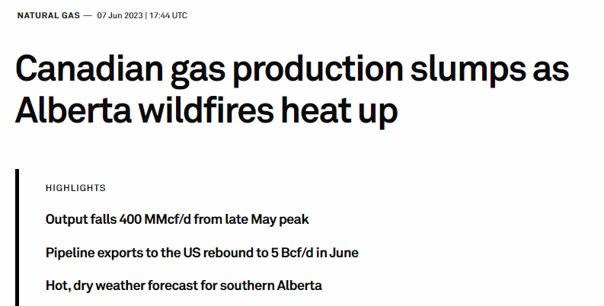
Motivation
Natural Gas Generates 72.6% of Electricity in Alberta (2022)*
*Annual Electricity Data by AUC - https://www.auc.ab.ca/annual-electricity-data/

Slide 3
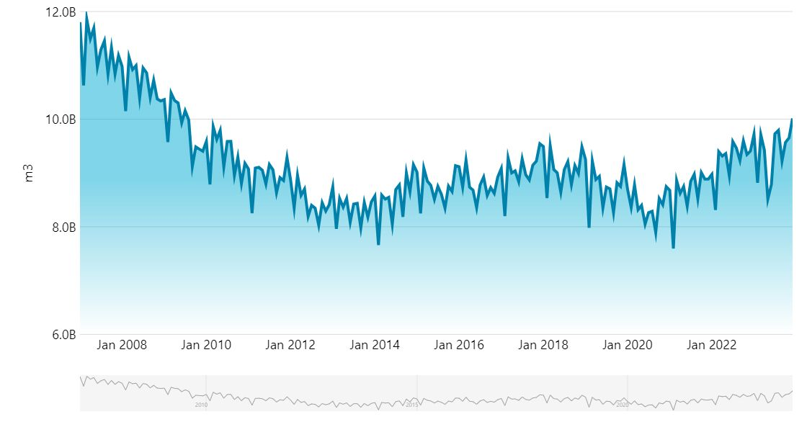
Alberta Natural Gas Production
In May 2023, marketable natural gas production was 8.5B cubic metres, down 9.66% from April 2023*. Compared to a historical average of 0.54% between 2007 and 2022. During May 2023, Alberta's wildfires were the worst the province has ever seen in the spring, with a record breaking 1,017,00 hectares burnt from the start of the fire season to May 23rd, 2023**.
*Natural Gas Production. Alberta Economic Dashboard. https://economicdashboard.alberta.ca/dashboard/natural-gas-production/
**2023 wildfires in Alberta worst record for Spring. CityNews Edmonton. https://edmonton.citynews.ca/2023/05/23/worst-spring-wildfire-season/#:~:text=Last%20Updated%20May%2023%2C%202023,fires%20have%20burnt%201%2C017%2C000%20hectares.

Slide 4
Data Ingestion, Cleaning, Compiling
Alberta Wildfire data: 2006.Apr to 2021.Dec - 22914 Individual Fires
https://www.alberta.ca/wildfire-maps-and-data
Natural Gas Historical Production in Alberta: 2007.Jan to 2023.Dec
https://economicdashboard.alberta.ca/dashboard/natural-gas-production
ST50: Gas Processing Plants in Alberta: 2001.Nov to 2023.May
https://www.aer.ca/providing-information/data-and-reports/statistical-reports/st50 - 1190 Individual Plants
Nova Gas Transmission Ltd. (NGTL) Pipeline: 2006.Jan to 2023.Sep
https://open.canada.ca/data/en/dataset/dc343c43-a592-4a27-8ee7-c77df56afb34

Slide 5
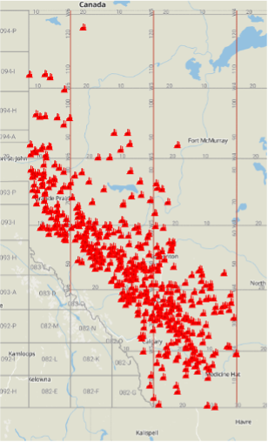
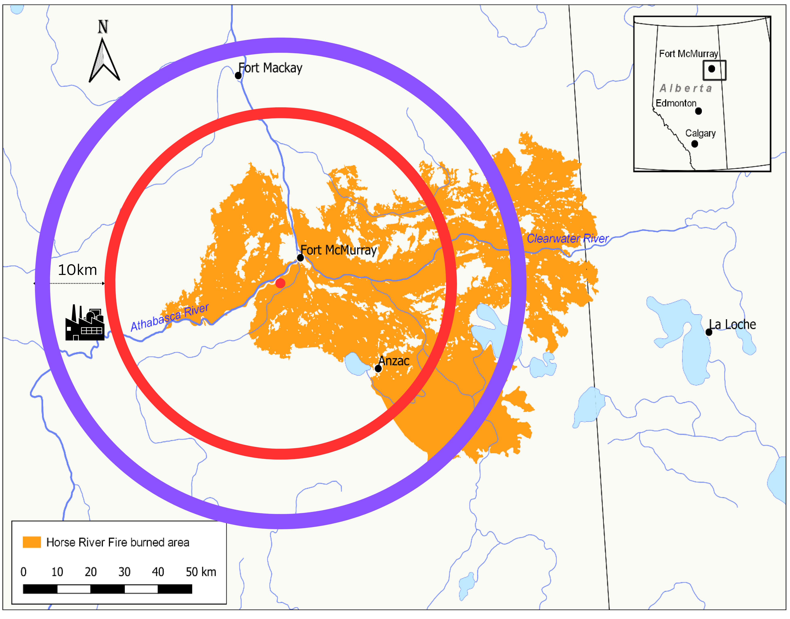
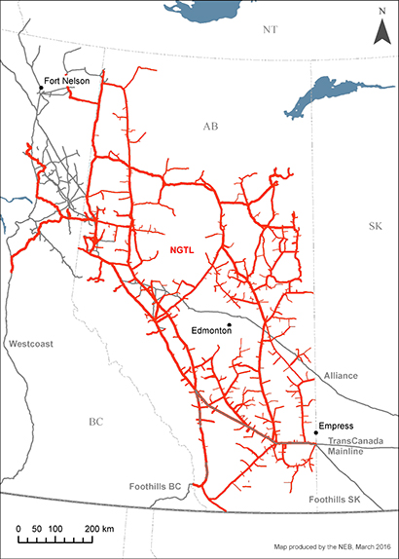
Feature Engineering
Nova Gas Transmission Ltd. system (NGTL)
Gas Plant Locations in Alberta
r=sqrt(A/π)
https://www.cer-rec.gc.ca/en/data-analysis/facilities-we-regulate/2016/group1-companies/natural-gas/canadas-pipeline-transportation-system-2016-ngtl.html
BOE Reports. https://boereport.com/2023/04/26/xi-technologies-alberta-gas-processing-a-summary/
Incentives and Barriers to Homeowners' Uptake of Firesmart. https://www.mdpi.com/2571-6255/5/3/80
Example: 2016 Horse River Wildfire

Slide 6
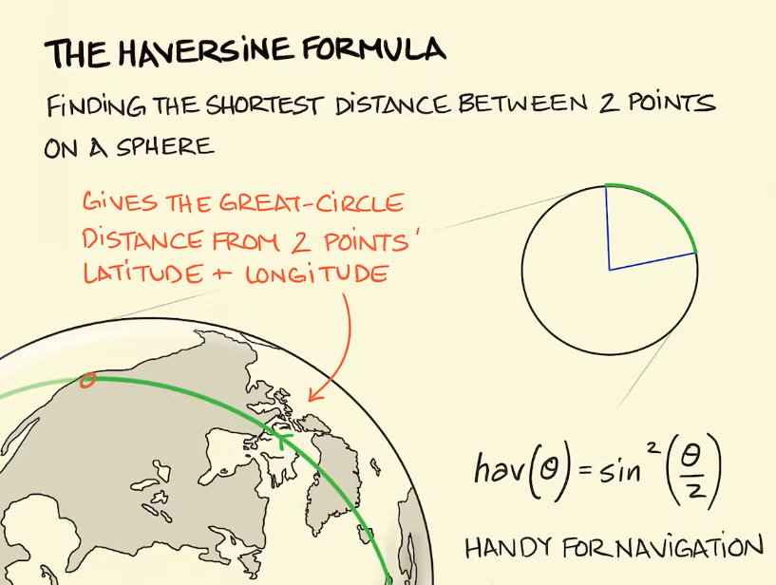
Fire Impact on Facilities & Infrastructures
Haversine Formula Use:
Calculated "as-the-crow-flies" distance between two points, factoring in Earth's curvature, using coordinates in radians.
Distance in Meters:
Applied Earth's radius (~6371 km) within the Haversine formula to output distance in meters.
Fire Impact Assessment:
Assessed if facilities are within a fire's impact zone by comparing the calculated distance to the fire's radius, assumed as a circle for simplicity.
Adds safety margins: 10 km* for gas plants and 5 km** for pipelines, based on industry safety standards, to account for indirect fire impacts.
https://sketchplanations.com/the-haversine-formula
*https://heatmap.news/guides/wildfire-evacuation-guide **Arbitrary Assumption

Slide 7
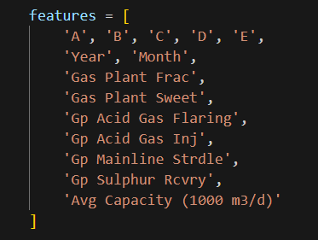
Final Model Features
# of Fire Size Class: ['A', 'B', 'C'. 'D', 'E'].
A class = 0 to 0.1 ha
B class > 0.1 ha to 4.0 ha
C class > 4.0 ha to 40.0 ha
D class > 40.0 ha to 200 ha
E class > 200 ha
Year: Fire year
Month: Fire Month
Gas Plant Frac Raw Gas Capacity (1000 m3/d): Gas Plant Fractionation: The process of boiling off the different hydrocarbons.
Gas Plant Sweet Raw Gas Capacity (1000 m3/d): The Process of removing hydrogen sulfides.
Gas Plant Flaring Raw Gas Capacity (1000 m3/d): Burning of natural gas
Gas Plant Acid Gas Inj Raw Gas Capacity (1000 m3/d): Gas Plant Acid Gas Injection
Gas Plant Mainline Strdle (1000 m3/d): Gas Plant Mainline Straddle. Recover NGL components
Gas Plant Sulphur Recovery Raw Gas Capacity (1000 m3/d)
Pipeline Gas Transmission Average Capacity (1000 m3/d):

Slide 8
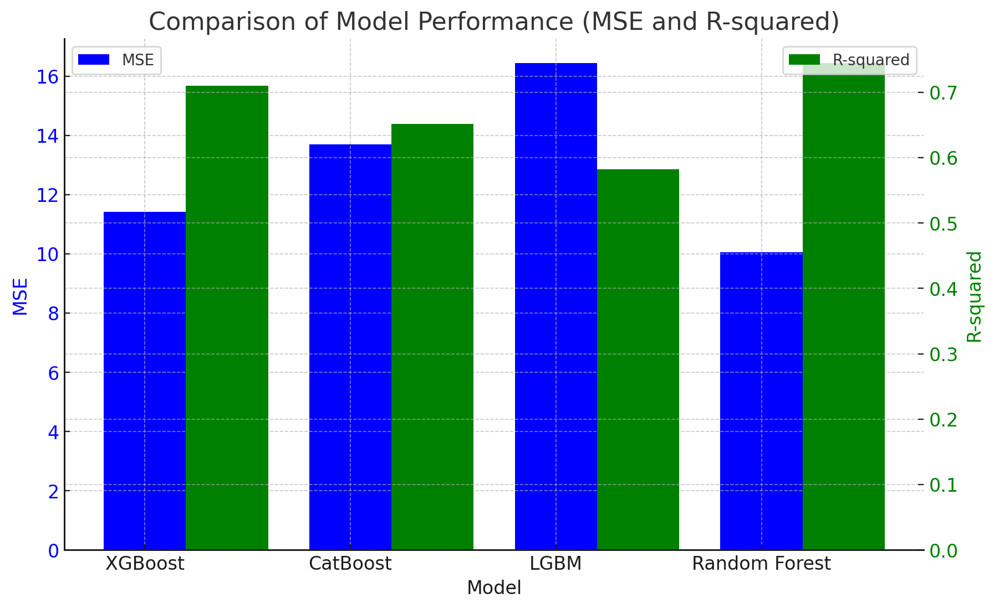
Results – Evaluation Metrics for each Model
XGBoost MSE: 11.4192, R-squared: 0.7095 Random Forest MSE: 10.0460, R-squared: 0.7444
CatBoost MSE: 13.6907, R-squared: 0.6517 LightGBM MSE: 16.4402, R-squared: 0.5818

Slide 9
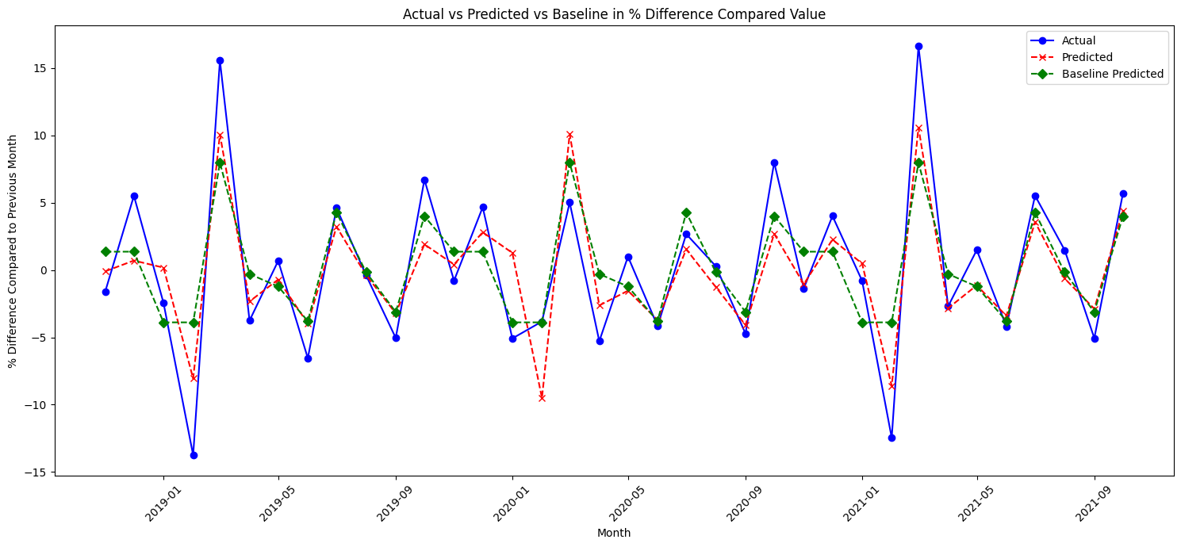
Results - % Difference Compared to Previous Month
Random Forest Regressor(Best Performing) MSE: 10.1542, R-squared: 0.7417
Baseline (Seasonal Pattern) MSE: 13.6521, R-squared: 0.6527

Slide 10
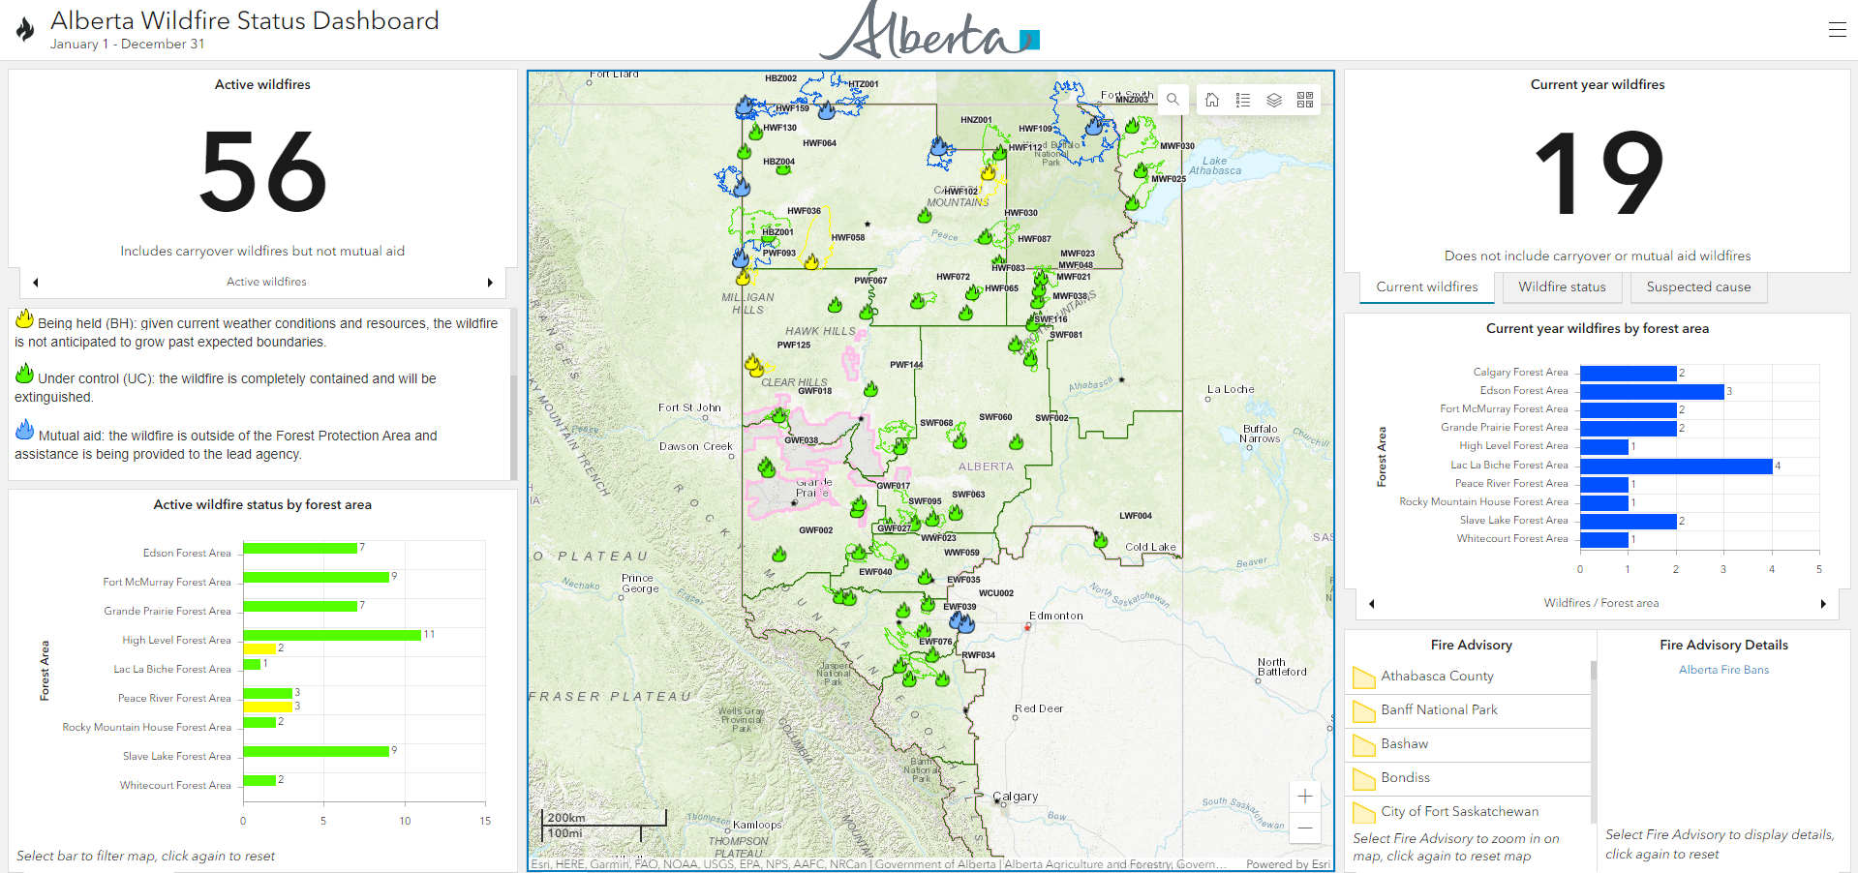
Alberta Wildfire Status Dashboard on ArcGIS
https://www.arcgis.com/apps/dashboards/3ffcc2d0ef3e4e0999b0cf8b636defa3

Slide 11

Real-time Wildfire Data available on CIFFC
The Canadian Interagency Forest Fire Centre (CIFFC) is a not-for-profit corporation owned and operated by the federal, provincial and territorial wildland fire management agencies
https://geoserver.ciffc.net/en/national-fires?filter_agency_code=All&stage_of_control=All&response_type=All&page=1&order=wildfire_agency_fire_id&sort=desc
Our model predicts a 9.49% decrease in Natural Gas Production for February 2024 in Alberta.

Slide 12
Difficulties Faced & Limitations
Isolating individual wells impacted by wildfires
Attributing Causality
In addition to gas processing plants and pipelines we also tried to incorporate individual gas wells. However, we struggled with isolating the location of each well.
Due to a multitude of factors influencing natural gas production (e.g. geopolitical influences, fluctuating demand, etc.) it is difficult to determine if an increase in wildfires in Alberta singlehandedly causes variation in natural gas production. However, we can confidently say that at least some of the change is due to wildfires.
Map-90: Designated Oil and Gas Fields, and Oil Sands Deposits. https://www1.aer.ca/productcatalogue/187.html

Slide 13
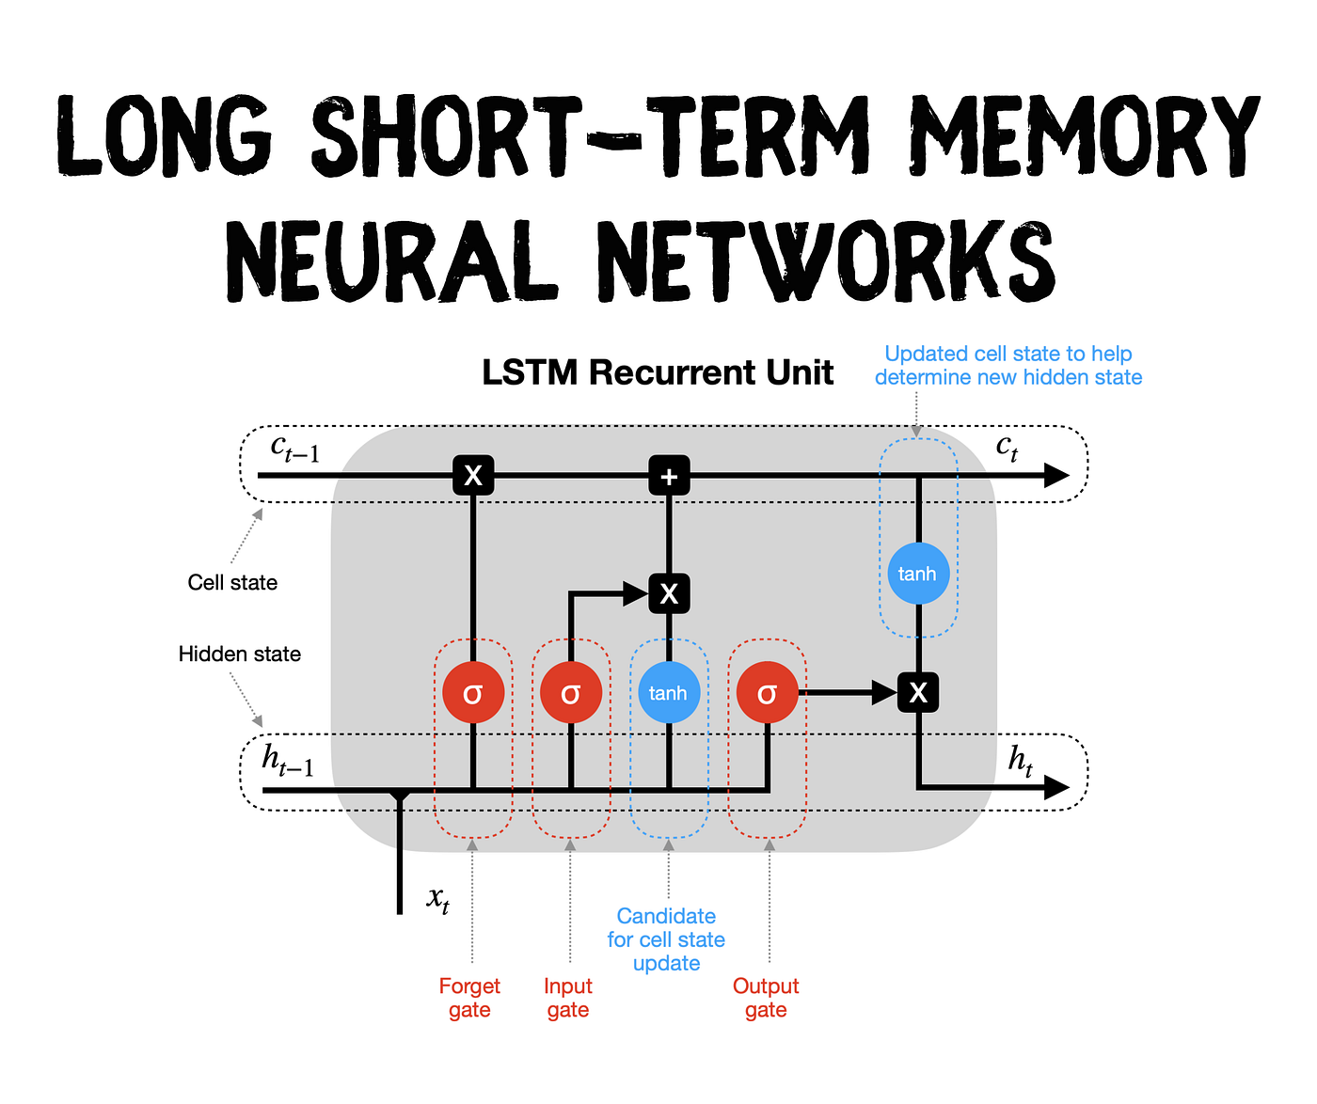
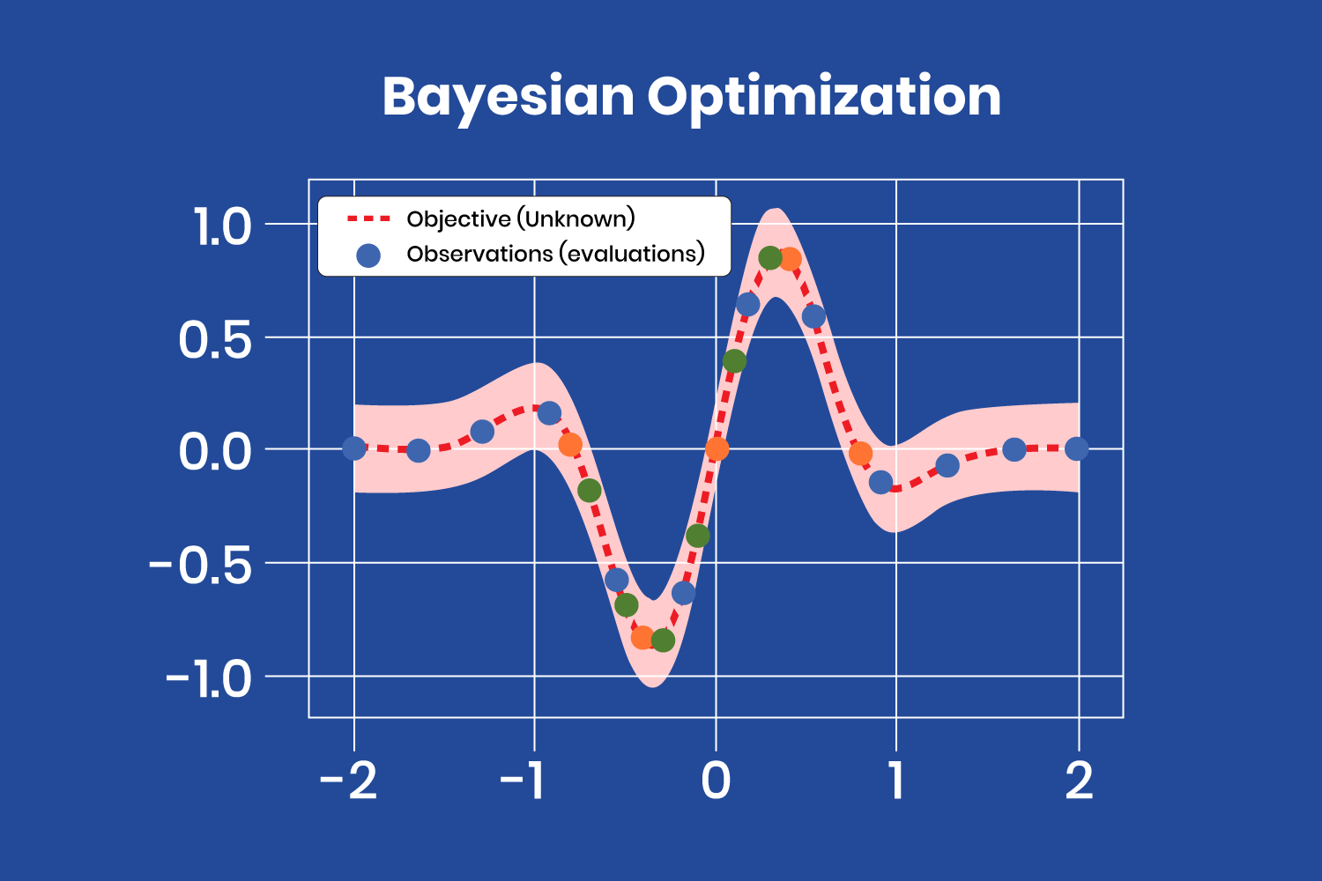
Trial Review: Opportunities for Improvement
Possible Application of Deep Learning Models
Long Short-Term Memory (LSTM) - R-squared 0.007
Hyperparameter Tuning
Bayesian Optimization
Overfitting

Slide 14
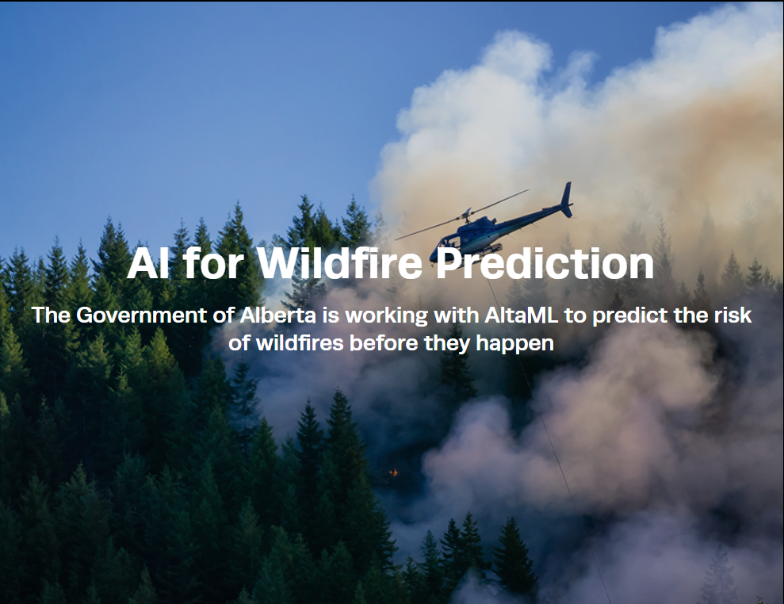
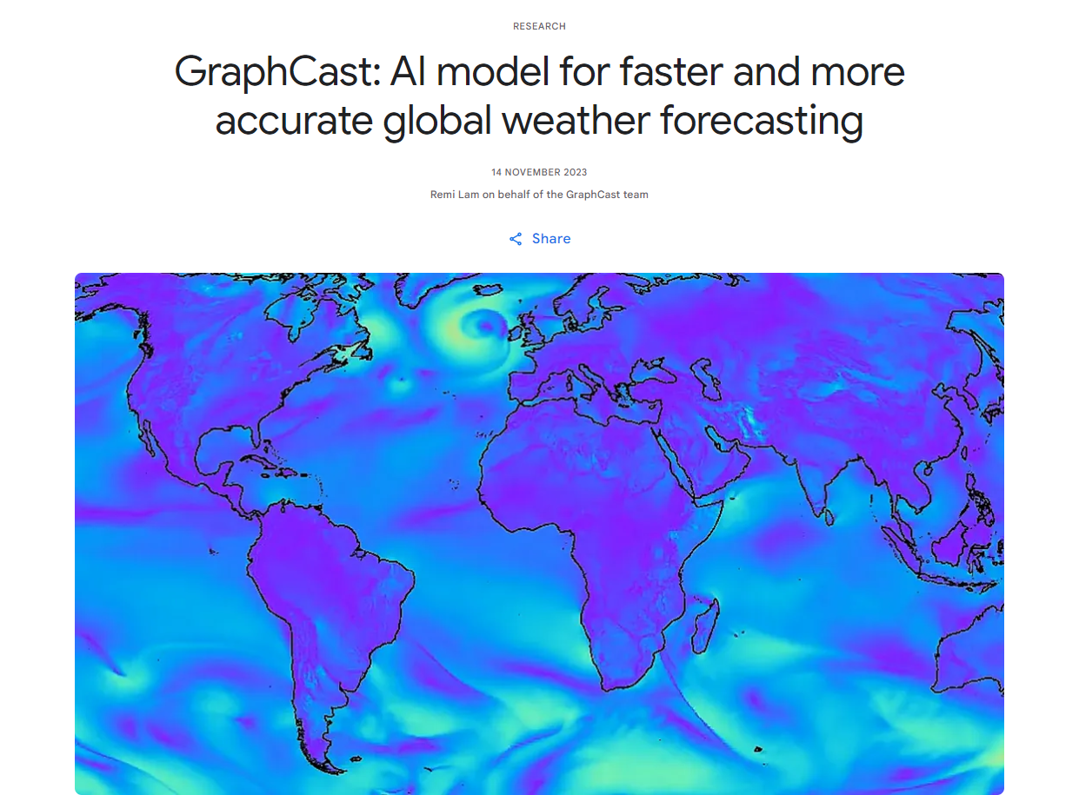

What's Next?
Incorporating state of the art wildfire prediction models to forecast impacts to Alberta's natural gas production.
AI for Wildfire Prediction. AltaML. https://www.govlab.ai/wildfire-prediction
Google Deepmind. https://deepmind.google/discover/blog/graphcast-ai-model-for-faster-and-more-accurate-global-weather-forecasting/

Slide 15

Thank you!
Tools Used:
Jupyter Notebook
Sklearn
XGBoost
CatBoost
LightGBM
Numpy
Pandas
Matplotlib
Tensorflow
Keras
Canva
Google Colab
https://github.com/gjftns7220/2024APICEnergyHackathon

